Slide 1
ONLINE BANKING SYSTEM
Submitted in the partial fulfillment for the award of the degree of
BACHELOR OF ENGINEERING
IN
BIG DATA ANALYTICS
Submitted by:
KOMATIREDDY YASHWANTH REDDY
20BCS3996
Under the Supervision of:
DIGVIJAY PURI
Department of AIT-CSE
DISCOVER . LEARN . EMPOWER

Slide 2
Outline
Introduction to Project
Problem Formulation
Objectives of the work
Methodology used
Results and Outputs
Conclusion
Future Scope
References

Slide 3
Introduction to Project
Online Banking is all about knowing our customer need and provide them with the right service at the right time through right channel 24*7 day a week.
Being “electronic”, it not only provides its customers with faster and better facilities, it even reduces the manual overhead of accounts maintenance.

Slide 4
Problem Formulation
Keeping track the all activities and their record on paper and error . It is also very efficient and a time consuming process of observing continuous increase in number of client visiting the bank. Recording and maintaining all the client record highly unreliable, inefficient and error pron.
The problem facing the current manual system is difficult to update and maintain, inconsistent data , insecurity , difficult to impose different various data files and difficult to data backup.
It is against this backdrop that automated database system is being developed to addressed the problem.

Slide 5
Objectives
The main objective of the Online Banking System is to manage the details of Accounts, Internet Banking, Transaction, Balance , Statement.
It manages all the information about Accounts, Customer, Statement, Accounts. The project is totally built at administrative end and thus only the administrator is guar-anteed the access.
The purpose of the project is to build an application program to reduce the manual work for managing the Accounts, Internet Banking, Customer, Transaction.
It tracks all the details about the Transaction ,Balance ,mini Statement, fixed deposit.

Slide 6
Methodology used
Bank Management System is based on a concept of recording customer's account details. Here the user can perform all the tasks like creating an account, deposit amount, withdraw amount, check balance, view all account holders detail, close an account and modify an account
This project is based on C++ programming language which gives added security to the project.
In this program code we mainly used file streams to manage the customer data stored in the database. Which gives user to view the data whenever required

Slide 7
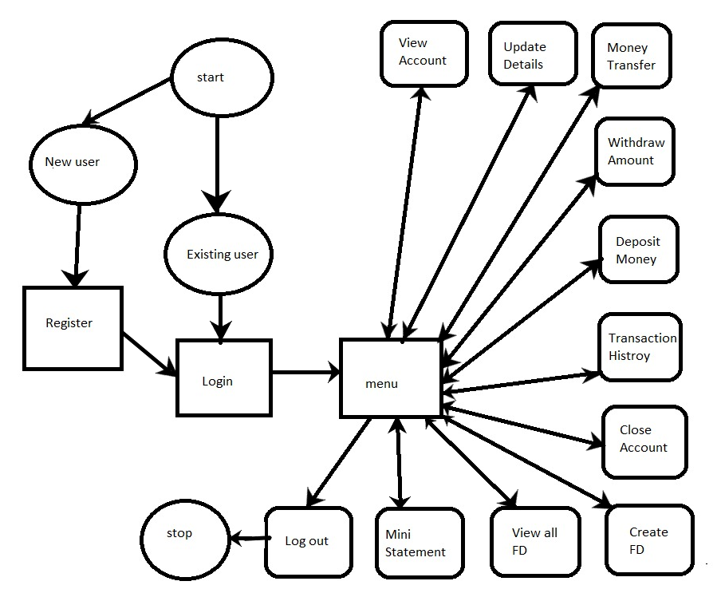
Flow chart

Slide 8
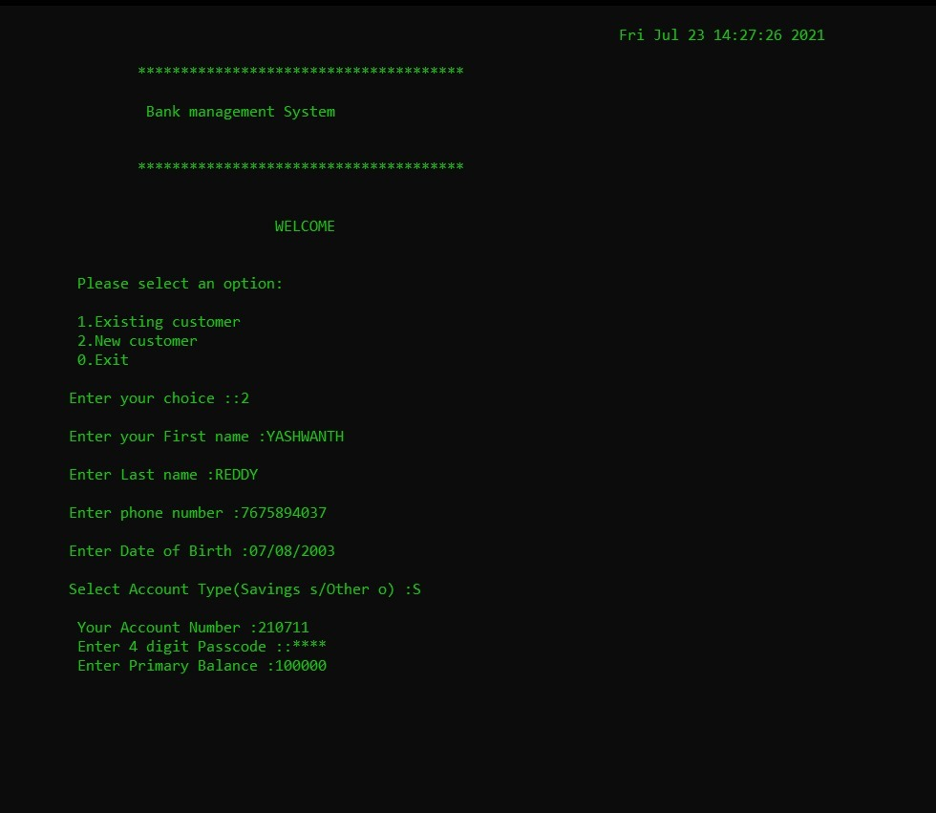
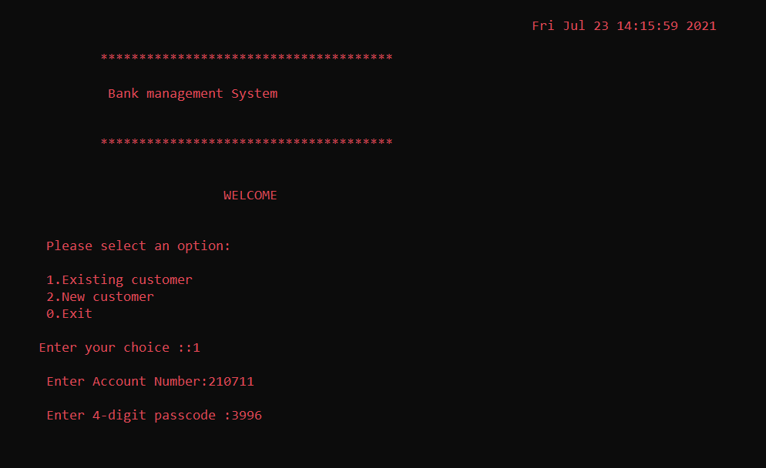
Login
Results and Outputs
Registration

Slide 9
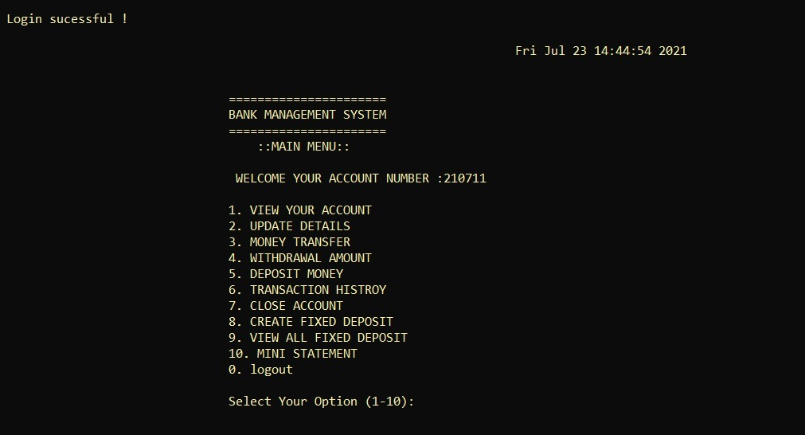
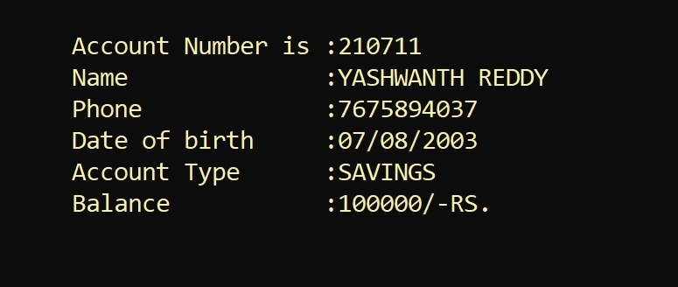
Menu Account details

Slide 10
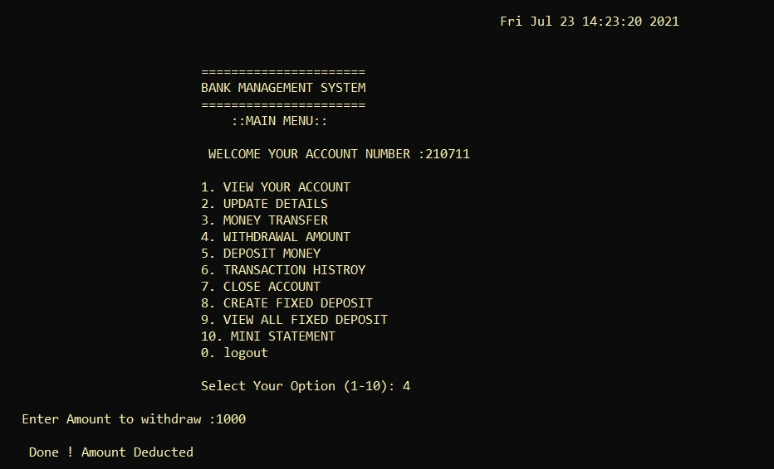
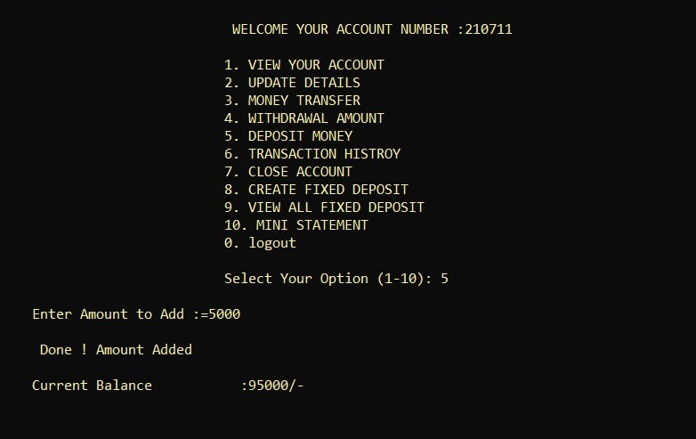
Withdraw Deposit

Slide 11
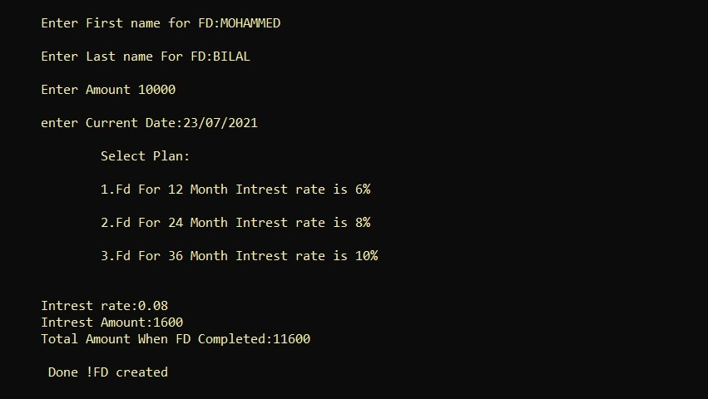
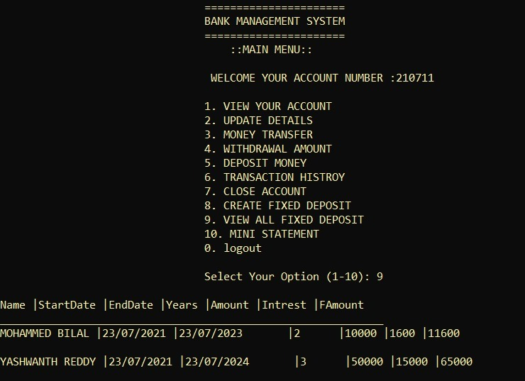
Fixed deposit Fixed deposit list

Slide 12
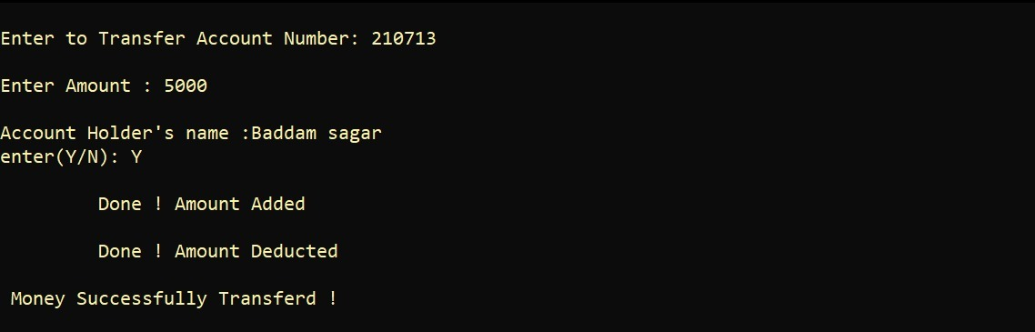
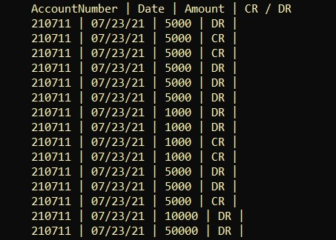
Money transfer Transaction History

Slide 13
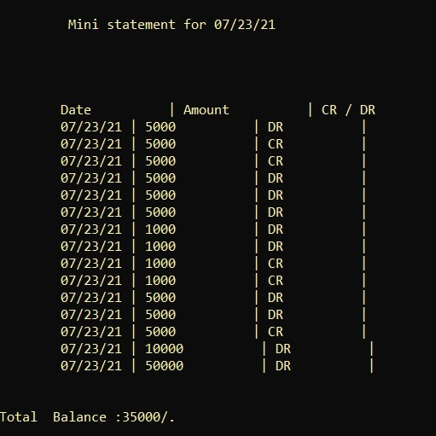
Mini statement

Slide 14
Conclusion
Bank management system is a virtualization of transactions in banking system. The banking system are used manual working but when we used online banking system it is totally virtualization process which avoid manual process and converts it in automatic process . If user can make a transaction in bank management system it is available in any were also user can link Aadhar with account, change branch location easily. Bank management system is saving the time with accuracy than bank manual system

Slide 15
Future Scope
Providing admin interface.
Currency exchange.
Customer should verify by mail.
Providing more security with huge databases.
Customer issues development based on their needs, so the help desk will be aware of their needs and easy to use.

Slide 16
References
https://www.geeksforgeeks.org/how-to-print-colored-text-in-c/ -
https://www.tutorialspoint.com/cplusplus/cpp_date_time.htm -
https://www.geeksforgeeks.org/file-handling-c-classes/ -
How%20to%20print%20colored%20text%20by%20using%20c++. –
https://instapdf.in/let-us-c-by-yashwant-kanetkar-2/
https://youtu.be/vNT4P23ihCo
https://youtu.be/azDHNMUuKcA

Slide 17


